Slide 1

patient involvement in clinical
nutrition guidelines and lay summaries
15 July 2019, Brussels
@eupatientsforum

Slide 2
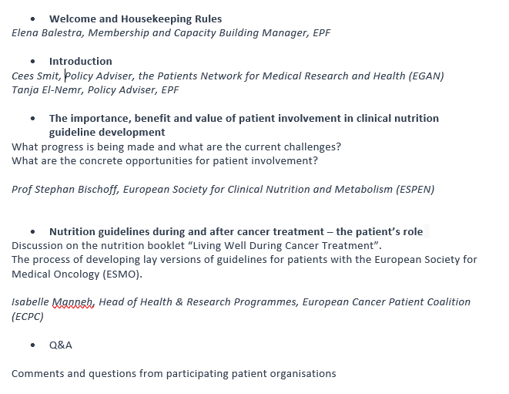
Agenda

Slide 3
2013/2014 Partner of ONCA Campaign and ENHA
2012/2013 Book ‘ Patient Perspectives on Nutrition’ with ENHA and EGAN
2012 MoU between EPF, ENHA and EGAN
2017 EU Patient Groups Conference on Nutrition
2017-2018 EPF Position statement on information to patients on food and nutrition
2018 EU Patient Task Force on Nutrition
2018 Nutrition Guidelines and lay person summaries
2019 Formal collaboration with ESPEN on patient involvement in guideline development and summaries
2019 EPF Cluster on Nutrition
EPF and Nutrition
EPF activities to date
Notes:
Before going to the other presentations, we will give you a quick overview of EPF work in this area of patient involvement.
EPF aims to first and foremost raise awareness of the role of nutrition and diet in managing long-term conditions, maintaining optimal health and quality of life; In relation to this, EPF published the book ‘Patient Perspectives on Nutrition, together with the European Nutrition for Health Alliance and
The Patients Network for Medical Research and Health.
Book: The main authors of which were Ceri Green, Chantal Gill’ard and Cees Smit.
This document highlights that nutrition is a vital part of health and can work both preventatively but also as an enabler for disease management. The background for this book is that nutrition is not an integral part of the disease management process yet, and many patients with chronic diseases face practical problems because of the incompatibility of nutritional needs with their disease or condition.
And concerning this, EPF together with European Nutrition for Health Alliance and
The Patients Network for Medical Research and Health developed a Memorandum of Understanding: in which these organisations commit to collaborative activities to raise awareness on the nexus between nutrition and an effective, integrated care continuum for patients.
The MoU formed the basis of numerous initiatives at EU and national level to drive forward nutrition through the lens of patients, and collaboration with a major European campaign – ONCA - Optimal Nutritional Care for All.
Cees Smit and Gaston Remmers have been the driving forces in raising the relevance of patients views on nutrition since the 2013 publication.
EPF, in line with its responsibilities as an agent for public health, for our specific constituency, has decided to elevate its strategy in the sphere of nutrition, with a particular accent on medical nutrition.
A recent milestone was a European Patients’ Conference on Nutrition in June 2017. The recommendations from this conference made the bridge between more generic awareness activities to more strategic focused work to drive nutrition as intrinsic to patient outcomes.
Based on the outcomes of the EU Patient Group Conference on Nutrition, in 2018, EPF set up an EU patient task force on nutrition, made up of volunteers from the EPF membership as well as other EU patient organisations.
The task force is facilitated and co-led by the EPF Secretariat and EGAN (Patients Network
for Medical Research and Health).
This taskforce developed this document on Clinical Nutrition Guidelines and Summaries for patients, which brings us to this webinar.
Still to come: Co-creation and mutual endorsement of a code of conduct for the medical nutrition industry, with MNI and EPF as key drivers

Slide 4
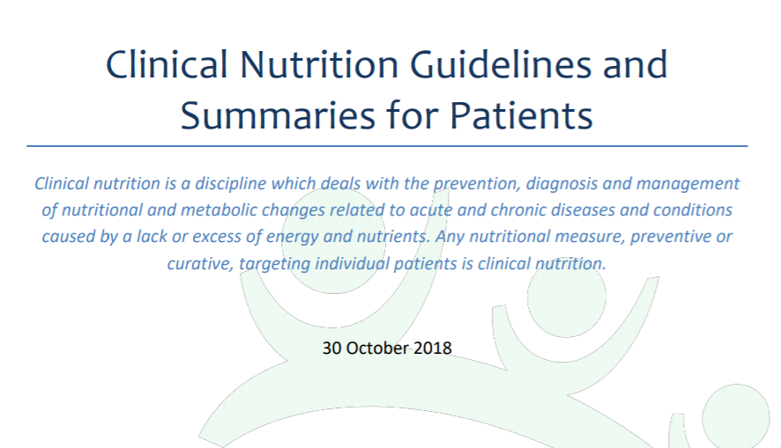
EPF and Nutrition

Slide 5
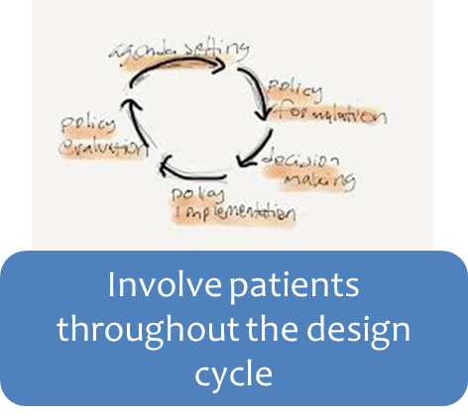
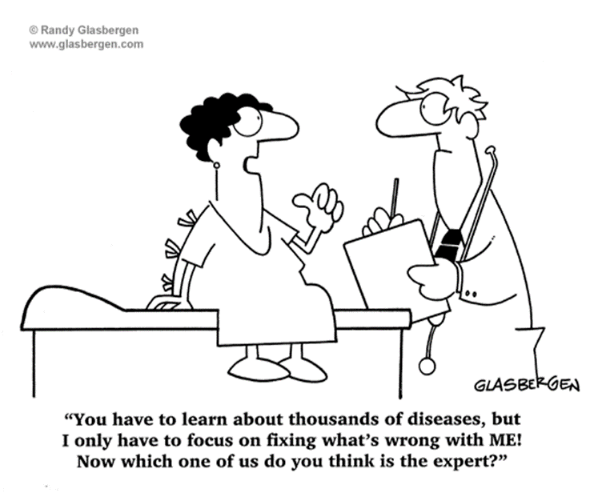
Clinical Nutrition Guidelines and Summaries for Patients - Nov 2018
WHAT is the paper about?
Underlines the importance of information to patients on food and diet choices;
Provides an overview of existing nutrition guideline development processes;
Highlights evidence based scientific nutrition guidance available for specific disease areas, while giving examples of existing examples of patient friendly summaries of this information and nutrition guidance developed by patient organisations for patients;
Explains why patient summaries of clinical nutrition guidelines are needed and aims to inspire scientific societies and guideline developers;
Provides recommendations for improving existing guideline development processes, improving patient involvement and the development of patient summaries.
Notes:
EPF launched last year a new paper about the development of clinical nutrition guidelines and the importance of summaries of these for patients as well as the need for improved patient involvement in the development processes, the importance of health literacy and informed decision-making concerning food and nutrition.
Based on the outcomes of a Patient Group Conference on Nutrition which took place last year and in line with EPF’s position statement, EPF together with EGAN setup an EU patient task force on nutrition, made up of volunteers from the EPF membership as well as other EU patient organisations, in order to guide this exercise of enhancing the development of comprehensive
summaries of recognised nutrition guidelines for patients, following the request of the patient community, in cooperation with scientific societies and health care professionals including The European Society for Clinical Nutrition and Metabolism (ESPEN) and the European Federation of the Associations of Dietitians (EFAD). This document also underwent consultation with the wider EPF membership.
So what is this paper about?

Slide 6
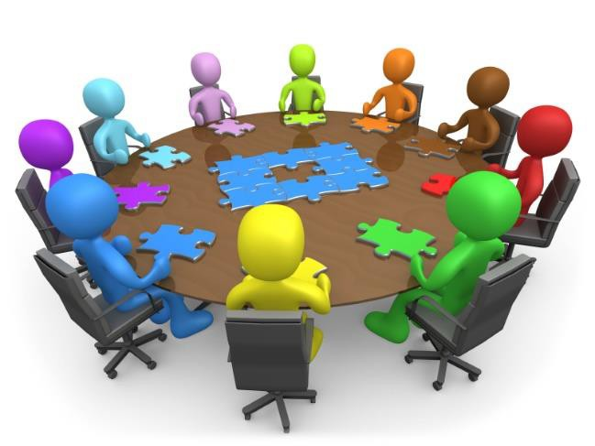


Nutrition Guideline Development and Lay Person Summaries (Nov 2018)
WHO is the document intended for?
Scientific societies and organisations developing clinical nutrition guidelines
Patients’ and carer organisations
Healthcare professionals and their organisations
Notes:
This document is primarily intended for scientific societies and organisations developing clinical nutrition guidelines and also patients’ and carer organisations.
Healthcare professionals who are called upon to give advice may also find this document useful.

Slide 7
Next Steps for EPF
EPF Collaboration with ESPEN
Lay version format of existing clinical nutrition guidelines for patients and caregivers are considered by both patients and ESPEN to be a high priority for future work
EPF and ESPEN are currently in the process of formalising a collaboration in the context of this project with respect to the development of patient versions of guidelines and to ensure strong patient involvement in the review of new guidelines
EPF will work closely with its membership and the wider patient community to facilitate patient involvement in ESPEN’s guideline related activities.
EPF also hopes to work closely with EFAD and dietitians who can use their expertise and people centred skills to ensure guidance is relevant and easily applied.
Notes:
ESPEN has recently started to work on a 2-year project which is dedicated to the improved dissemination of existing clinical practice guidelines and standards and implementation into practice. This comprises 4 components: shortened versions of the guidelines for practitioners, translation of shortened versions into national languages, guideline apps and lay versions of the shortened guidelines in an accessible format for patients.
To this end, I am pleased to say that good progress has already been made on this front. EPF and ESPEN are currently… 2.
The process of better patient involvement is not a bottom-down process but depends on mutual interrelation between patient organisations on the one hand and readiness to accept patients’ involvement by scientific societies and bodies on the other hand. EPF can support by describing and providing guidance on the frame which facilitates and enhances patient involvement but not the specific detailed work and interaction, which very often has to consider disease specific, or national contexts and circumstances. With this, EPF looks forward to working closely with its membership to improve clinical nutrition guidance for patients in Europe. (3)
4. EPF also hopes to work closely with EFAD, European Federation of the Associations of Dietitians and dietitians who can use their expertise and people centred skills to ensure guidance is relevant and easily applied.
With these organisations and others we look forward to co-developing guidelines in an accessible format for patients.

